Slide 1


Slide 2
Presented By:
Abhishek Mishra
submission Date:09/02/2023

Slide 3
Cause of Deaths
Objective, problem statement, EDA process and data analysis

Slide 4
Agenda of the Project(Cause of deaths):-
The purpose of a cause of death dataset is to provide information on the various factors that contribute to mortality and the mortality patterns in a given population.
This information can be used for various purposes such as public health research, medical statistics, and health policy analysis.
The dataset typically includes information such as demographic information of the deceased, as well as the specific cause of death, such as diseases, accidents, or other medical conditions.
By analyzing this information, researchers and policymakers can gain insights into the health status of the population, identify risk factors, and develop strategies to prevent deaths and improve health outcomes.

Slide 5
Problem Statement
A straightforward way to assess the health status of a population is to focus on mortality – or concepts like child mortality or life expectancy, which are based on mortality estimates.
A focus on mortality, however, does not take into account that the burden of diseases is not only that they kill people, but that they cause suffering to people who live with them. .
Assessing health outcomes by both mortality and morbidity (the prevalent diseases) provides a more encompassing view on health outcomes. This is the topic of this entry.
The sum of mortality and morbidity is referred to as the ‘burden of disease’ and can be measured by a metric called ‘Disability Adjusted Life Years‘ (DALYs). DALYs are measuring lost health and are a standardized metric that allow for direct comparisons of disease burdens of different diseases across countries, between different populations, and over time.
Conceptually, one DALY is the equivalent of losing one year in good health because of either premature death or disease or disability. One DALY represents one lost year of healthy life.

Slide 6
Problem Statement
The first ‘Global Burden of Disease’ (GBD) was GBD 1990 and the DALY metric was prominently featured in the World Bank’s 1993 World Development Report.
Today it is published by both the researchers at the Institute of Health Metrics and Evaluation (IHME) and the ‘Disease Burden Unit’ at the World Health Organization (WHO), which was created in 1998. The IHME continues the work that was started in the early 1990s and publishes the Global Burden of Disease study.

Slide 7
Analysis of Dataset & Problem Statement:-
In this Dataset, we have Historical Data of different cause of deaths for all ages around the World.
The key features of this Dataset are: Meningitis, Alzheimer's Disease and Other Dementias, Parkinson's Disease, Nutritional Deficiencies, Malaria, Drowning, Interpersonal Violence, Maternal Disorders, HIV/AIDS, Drug Use Disorders, Tuberculosis, Cardiovascular Diseases, Lower Respiratory Infections, Neonatal Disorders, Alcohol Use Disorders, Self-harm, Exposure to Forces of Nature, Diarrheal Diseases, Environmental Heat and Cold Exposure, Neoplasms, Conflict and Terrorism, Diabetes Mellitus, Chronic Kidney Disease, Poisonings, Protein-Energy Malnutrition, Road Injuries, Chronic Respiratory Diseases, Cirrhosis and Other Chronic Liver Diseases, Digestive Diseases, Fire, Heat, and Hot Substances, Acute Hepatitis.
These all key features are analysed the year wise death rate for different countries.

Slide 8
EDA Process:-
Explore the data analysis by the help of some functions and library to find out whether the data is perfect or not
Finding for the ‘Missing Values’
Treatment of the missing value by using some statistics(mean value)
Checking for the skewness in the data and found some variable has some skewness
Used different data visualization methods to visualize the data
Some statistics I have used for the Univariate analysis and to find the correlation between the features.
Found the Outliers by using the Data Visualization.
Used the boxplot to see the outliers in the data.

Slide 9
EDA
Importing the ‘scipy’ library and used the zscore method for treatment of the outliers in the data.
We are going to use the different types of plots for Univaraite analysis and bivariate analysis to find out the relation between variables and target.
Completed all the Data preprocessing and feature engineering
Treated the skewed data by using log and PowerTransformer method.
Treated the Outliers present in the Dataset by using Zscore method.

Slide 10
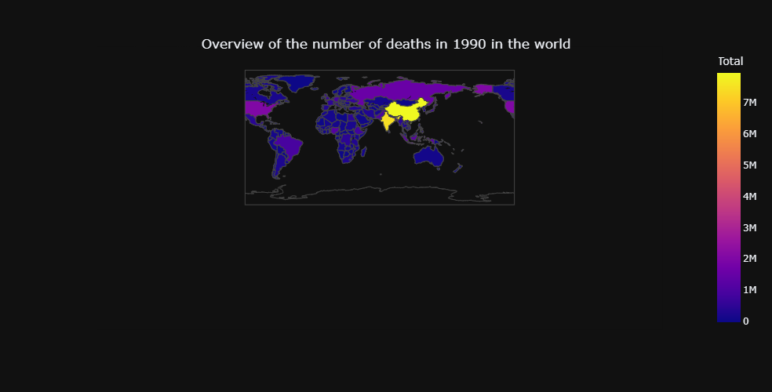
DATA ANALYSIS:-
Split the data of Year and Country from the Dataset
Overview the Number of Death in the 1990 by using the graph.

Slide 11
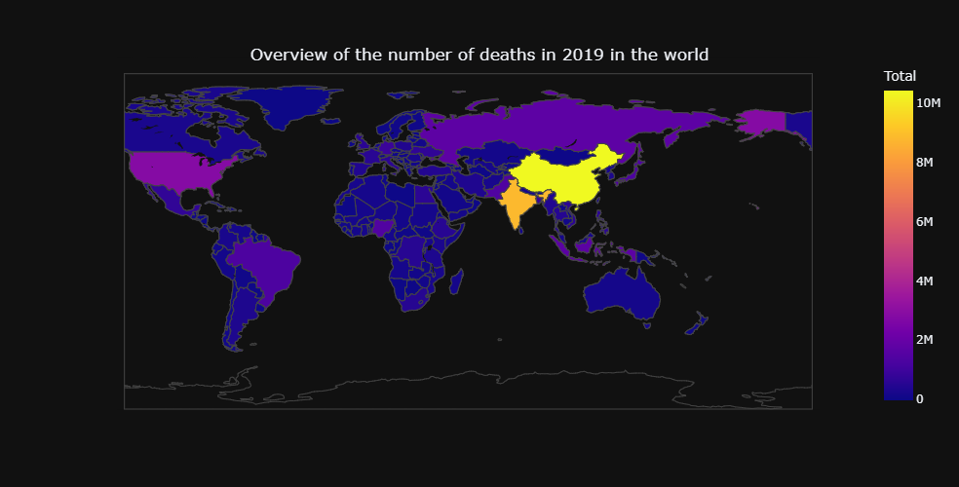
DATA ANALYSIS:-
Overview of Number of Death in 2019 by using the graph.

Slide 12
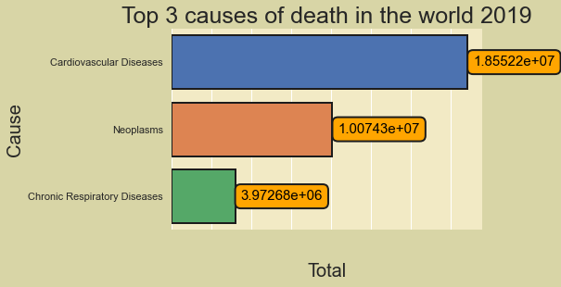
Data Analysis:-
From the Data Analysis we can found the leading cause of the Death from all the causes listed in the history data.

Slide 13
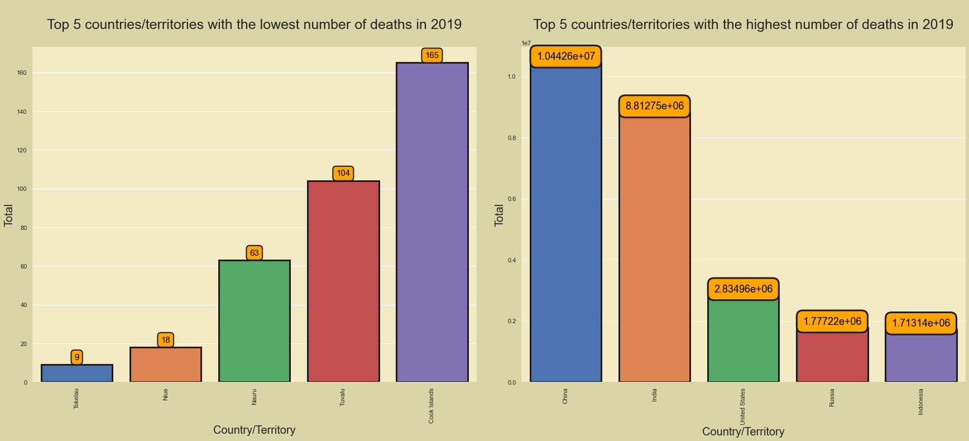
Observations:-
From Previous slide and Data analysis we can observe that the death rate is directly proportional to the population.
As much as the population is increasing, the death rate is also getting increased by year.
Here I am attaching the statistics for the top 5 countries with highest number of death and lowest number of deaths.

Slide 14
Data Analysis:-
In the previous slide We have observed that China, India, United states, Russia, Indonesia are the respectively countries with the highest number of Death rate.
While these 5 countries are the lowest deathrate listed as- Tokelau, Niue, Nauru, Tuvalu, cook island.
While analysing the data we can say that with the help of analysis we can prevent the death and reduce the causes for the death
By data visualisation we can observe the several important cause and deaths due to that particular cause by year across the countries.

Slide 15
Conclusion:-
This type of dataset is important for understanding patterns and trends in mortality and can be used by public health researchers, epidemiologists, and policymakers to inform strategies for reducing deaths and improving population health.
The data can be used to identify leading causes of death and disparities in mortality among different populations. It can also be used to monitor changes over time and assess the impact of interventions aimed at reducing deaths from specific causes .
We did all the EDA process for the machine model building but only analysis the data.
The dataset is related to the Unsupervised learning in which there is only independent variable means the dataset is without the Label. So if we want to build the model ,needed to do the clustering method.
These all the steps are done in jupyter notebook for the data analysis.

Slide 16
Thank You

